Slide 1








PERSONAL DIARY
MANAGEMENT SYSTEM
Simple. Secure. Personal. Your thoughts, locked in code.
Fabiha Raiyan Aminur Rashid Sohag Group-7 Tanvir Ahmed Ovi Imtiaj Ahmed

Slide 2

Kelompok Garangan
Jurusan Seni Budaya Manusia
OBJECTIVES
01
Build a Secure Personal Diary System: A C-based console application that lets users maintain personal diary entries locally and securely.
05
Apply and Demonstrate Core C Concepts: Use this project to reinforce understanding of structures, arrays, functions, conditionals, loops, and file I/O.
02
Perform Core Diary Operations (CRUD):
For now, all operations are based on dates (YYYY-MM-DD format) — one entry per date is allowed.
03
Store Data with Basic Encryption: Use XOR encryption to store data securely in a binary file, preventing direct reading or tampering.
04
Simplify User Input and Experience: Offer meaningful prompts, warnings, and instructions for smooth interaction.
Fabiha Raiyan Aminur Rashid Sohag Group-7 Tanvir Ahmed Ovi Imtiaj Ahmed

Slide 3
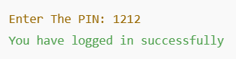


Kelompok Garangan
Jurusan Seni Budaya Manusia
AUTHENTICATION
sample output
Entry Point: When the program starts, it immediately calls the authenticate() function. User is prompted to enter a PIN.
Why Authentication First? To protect the diary content from unauthorized access. Without correct credentials, no other features are accessible.
How it works:
PIN check (1212) before access
Wrong PIN? Access denied.
code snippet
if (x == 1212) {
printf("You have logged in successfully\n");
return 1;
} else {
printf("You Have Entered a Wrong PIN\n");
return 0;
}
Fabiha Raiyan Aminur Rashid Sohag Group-7 Tanvir Ahmed Ovi Imtiaj Ahmed

Slide 4

RUMUSAN MASALAH
DESIGN & ADDITION OF ENTRIES
Main Menu
How addEntry() Works
Encryption / Decryption
After successful PIN authentication, user sees a menu with options:
1. Add Entry
2. View Entry
3. Search Entry
4. Edit Entry
5. Delete Entry
6. Exit
The system keeps running inside a loop, asking for a choice.
Based on the number entered, it calls the relevant function, like addEntry()
Input Date : User is asked to enter a date. Date is validated (correct format, calendar date)
Duplicate Check : If an entry with that date already exists, user is asked to Edit that entry instead.
Input Title & Content : After date verification, user enters the content.
Saving : Entry is encrypted, saved into memory and immediately written to file using saveEntries().
Basic X-OR for Reversible Masking
text[i] ^= ENCRYPTION_KEY;
(takes each character in the text and X-ORs it with a fixed key which scrambles the character.)
This way, if someone tries to open the file manually, they will only see unreadable texts or gibberish.
Same X-OR Logic is used again to decrypt and recover the original text.
Fabiha Raiyan Aminur Rashid Sohag Group-7 Tanvir Ahmed Ovi Imtiaj Ahmed

Slide 5
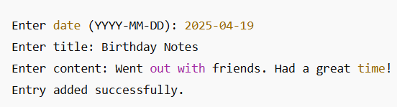
Demo Output of Add Entry:
Fabiha Raiyan Aminur Rashid Sohag Group-7 Tanvir Ahmed Ovi Imtiaj Ahmed

Slide 6
SAVE & LOAD MECHANISM
saveEntries()
loadEntry()
Opens diaryy.txt in binary read mode (rb).
Uses fread() to read each encrypted entry from the file.
Immediately decrypts all fields using the
same XOR function.
Loads them into the entries[] array so users can view, edit, or delete them.
Called once the program starts, after successful login.
Opens diaryy.txt in binary write mode (wb).
Each entry’s date, title, content is encrypted using XOR.
Then saved using fwrite() into the file.
Data is decrypted again in memory (so the entries stay readable within the program).
Called after any changes like Add, Edit or Delete.
Fabiha Raiyan Aminur Rashid Sohag Group-7 Tanvir Ahmed Ovi Imtiaj Ahmed

Slide 7

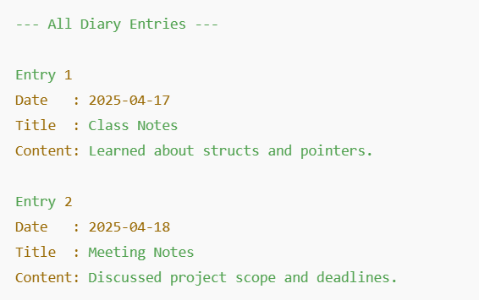
VIEW AND SEARCH FUNCTIONALITY
void viewEntry() {
// Loops through all saved entries and displays their details
}
Sample Output:
VIEWING
Purpose: To display every diary entry stored in the system.
How It Works:
Checks if any entries exist (entryCount == 0).
If entries are found, it loops and prints them with:
Entry number
Date
Title
Content
3. If no entries are present, shows an appropriate message.
Fabiha Raiyan Aminur Rashid Sohag Group-7 Tanvir Ahmed Ovi Imtiaj Ahmed

Slide 8
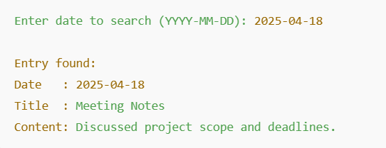
VIEW AND SEARCH FUNCTIONALITY
SEARCHING
Purpose: To find and display a diary entry saved for a specific date.
User is prompted to enter a date in YYYY-MM-DD format.
The input is validated to ensure it's a real date.
The program loops through saved entries and compares the date.
If a match is found, it displays the title and content.
If no match is found, it notifies the user.
void searchEntry() {
// Takes date input, validates, and searches in entries[]
}
Sample Output:
Fabiha Raiyan Aminur Rashid Sohag Group-7 Tanvir Ahmed Ovi Imtiaj Ahmed

Slide 9
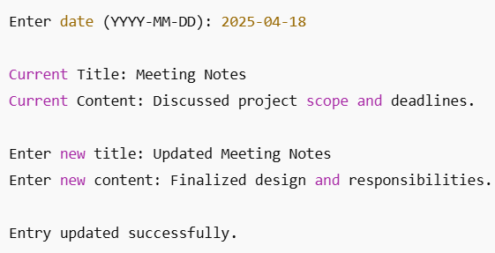


EDIT ENTRY
Purpose:
Modify the title or content of an existing diary entry based on a specific date.
How It Works:
Prompts the user to enter a date (YYYY-MM-DD).
Validates the format and checks if the entry exists.
If found, it displays the current title and content.
User is asked to input a new title and content.
Changes are saved back into the file using saveEntries().
void editEntry() {
// Accepts date input, validates, and allows editing title/content
}
Sample Output:
Fabiha Raiyan Aminur Rashid Sohag Group-7 Tanvir Ahmed Ovi Imtiaj Ahmed

Slide 10
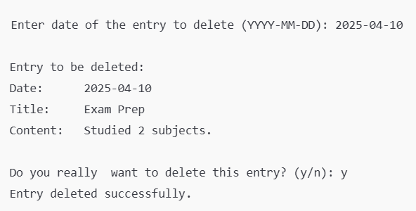

DELETE ENTRIES
Purpose:
Remove an entry from the diary permanently using its date.
How It Works:
User is asked for the date of the entry they want to delete.
Validates the date format and checks for a matching entry.
Displays the entry details before deletion.
Asks for confirmation (y/n).
If confirmed, deletes the entry by shifting the array.
Saves updated entries using saveEntries().
Sample Output
Fabiha Raiyan Aminur Rashid Sohag Group-7 Tanvir Ahmed Ovi Imtiaj Ahmed

Slide 11

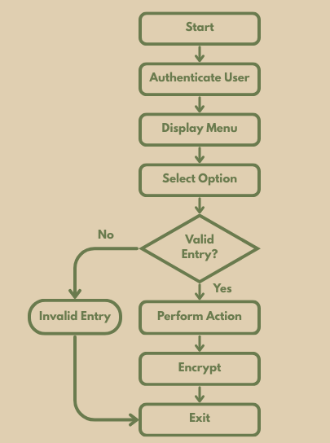


TUJUAN
USER MANUAL
Diagram
PIN check → Menu → Add/View/Edit/Delete/Search
File saved with XOR encryption for privacy.
Features
Fabiha Raiyan Aminur Rashid Sohag Group-7 Tanvir Ahmed Ovi Imtiaj Ahmed

Slide 12
FUTURE SCOPES
Future Enhancements:
Introduce Multi User Support (account creaton, login, logout)
Introduce password change
Unlimited Entries using malloc() realloc() instead of a fixed sized array.
Search by keyword alongside of date.
END
Fabiha Raiyan Aminur Rashid Sohag Group-7 Tanvir Ahmed Ovi Imtiaj Ahmed

Slide 13

BAB 4:
KESIMPULAN
THANK YOU
FOR YOUR ATTENTION!
Fabiha Raiyan Aminur Rashid Sohag Group-7 Tanvir Ahmed Ovi Imtiaj Ahmed

